Slide 1

LIBRARY MANAGEMENT SYSTEM
END TERM REPORT
BY
40 11903375 Ayush Mourya RK19EGB40
41 11903390 Asim Ali Khan RK19EGB41
42 11903392 Anurag Agrawal RK19EGB42
Section: K19EG
Roll Number: 40, 41 and 42
CSE326 : Internet programming laboratory
School of computer Science Engineering Lovely professional University
Date of Submission : 00.04.2020
Submitted to : NIKITA MAM
Section: K19EG
Roll Number: 34,35

Slide 2
CONTENTS
PAGE NO.
STUDENT DECLARATION……………………………………………………………………... 3
INTRODUCTION……………………………………………………………......................... 4
ABSTRACT ……………………………………………………………................................. 5
OBJECTIVES………………………………………………………………………..................... 6
SYSTEM REQUIREMENTS……………………………………..………………………………. 7
PICTORIAL FLOW OF PROJECT………………………………………........................… 8
SNAPSHOTS…………………………………………………………….....................………… 9 -11
OUR CONTRIBUTIONS………………………………………....................…………….... 12 - 14

Slide 3
STUDENT DECLARATION
This is to be declare that this report has been written by us . No part of the report is copied from other sources. All information including from other sources have been duly acknowledged. We aver that if any part of the report is found to be copied, we are shall take full responsibility for it.
Name: Ayush Mourya
Reg. No.: 11903375
Roll Number: 40
Name: Asim Ali Khan
Reg. No.: 11903390
Roll Number: 41
Name: Anurag Aggarwal
Reg. No.: 11903392
Roll Number: 42

Slide 4
INTRODUCTION
This project LIBRARY MANAGEMENT SYSTEM has been developed on HTML, CSS and JavaScript. The main object of developing this project was to create a static website for the management of library system, from which user can get the complete details of the books and magazines such as about the name, author, writer, publisher, date of publish, book edition, availability etc. This project is in HTML and CSS so it’s a static website and does not perform any type of dynamic database operations. The object of this project is to develop a system that automates the processes and activities of a library management system. In this project we will make an easier task of searching the availability and details of the books in the library. In the present system a user has a approach to all the details of the book.

Slide 5
ABSTRACT
Library management system is a project which aims in developing a computerized system to maintain all the daily work of library .This project has many features which are generally not available in normal library management systems like facility of user login and a facility of teachers login. It also has a facility of admin login through which the admin can monitor the whole system .It also has facility of an online notice board where teachers can student can put up information about workshops or seminars being held in our colleges or nearby colleges and librarian after proper verification from the concerned institution organizing the seminar can add it to the notice board.
It has also a facility where student after logging in their accounts can see list of books issued and its issue date and return date and also the students can request the librarian to add new books by filling the book request from. The librarian after logging into his account i.e., admin account can generate various reports such as student report, issue report, teacher report and book report Overall this project of ours is being developed to help the students as well as staff of library to maintain the library in the best way possible and also reduce the human efforts.

Slide 6
OBJECTIVES
The project aims and objectives that will be achieved after completion of this project are discussed in this subchapter. The aims and objectives are as follows:
Online book issue
Request column for librarian for providing new books
A separate column for digital library
Student login page where student can find books issued by him/her and date of return.
A search column to search availability of books
A teacher login page where teacher can add any events being organized in the college and important suggestions regarding books.
Online notice board about the workshops.

Slide 7
Library Management System
Division Of Computer Science And Engineering Page 8
1.5 OPERATION ENVIRONMENT
PROCESSOR INTEL CORE PROCESSOR OR BETTERPERFORMANCEOPERATING SYSTEM WINDOWS VISTA ,WINDOWS7, UBUNTUMEMORY 1GB RAM OR MOREHARD DISK SPACE MINIMUM 3 GB FOR DATABASE USAGE FORFUTUREDATABASE MY SQL
SYSTEM REQUIREMENTS:
PROCESSOR - Intel core processor or better processor
OPERATING SYSTEM - Windows VISTA ,Windows 7, UBUNTU
MEMORY - 1GB RAM or morehard disk space minimum 3 GB

Slide 8
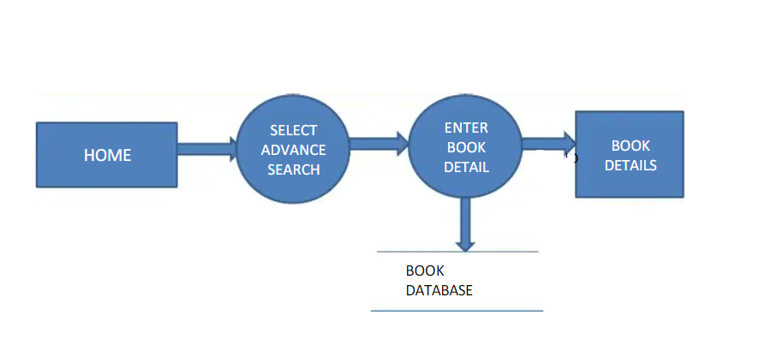
PICTORIAL FLOW OF PROJECT

Slide 9
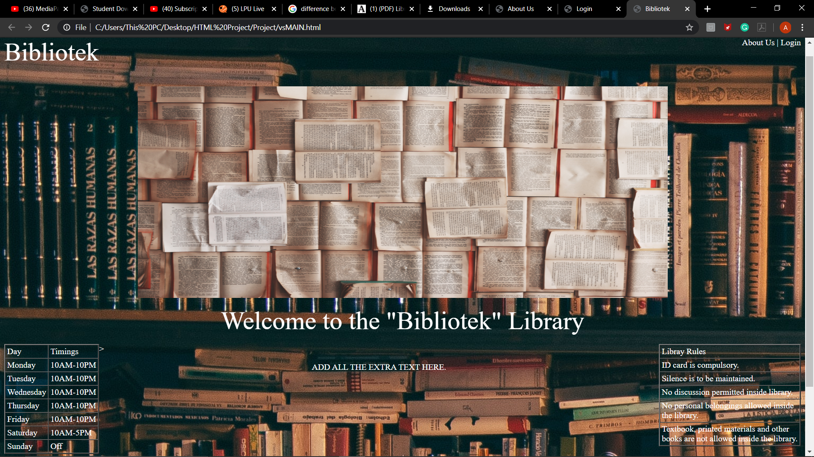
SNAPSHOT - 1

Slide 10
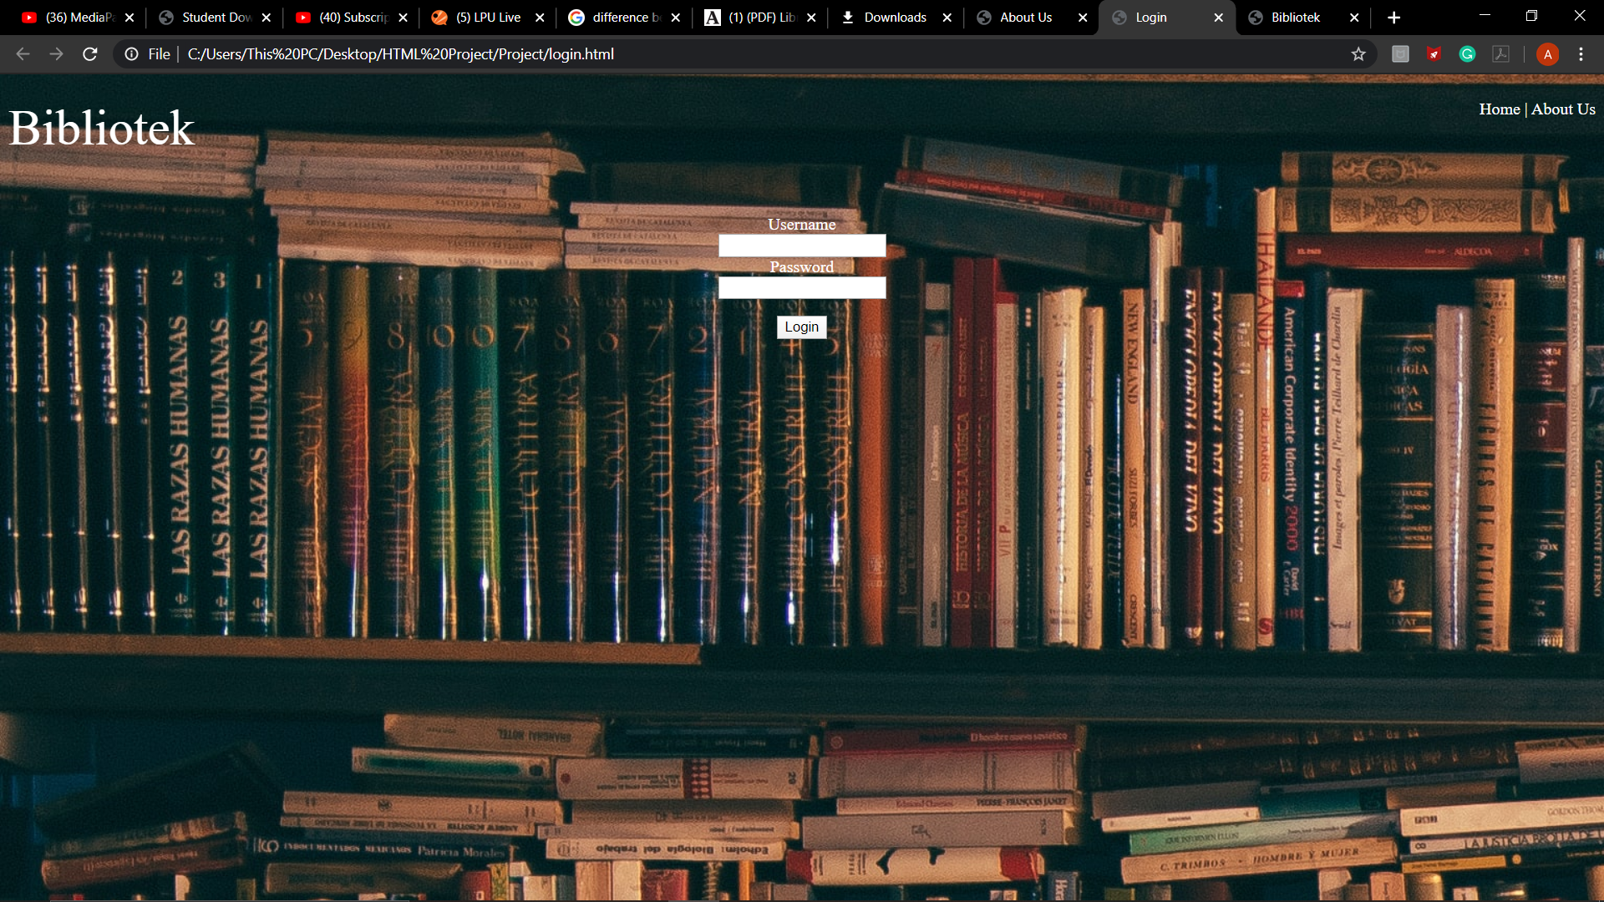
SNAPSHOT - 2

Slide 11

SNAPSHOT - 3

Slide 12
MY CONTRIBUTION
Ayush Mourya:
For making this project I have studied HTML,CSS and JavaScript.
For making this library management website I have observed many universities and private libraries websites.
I have made project report in this project.

Slide 13
MY CONTRIBUTION
Asim Ali Khan:
For making this project I have studied HTML,CSS and JavaScript.
For making this library management website I have observed many universities and private libraries websites.
I have made webpage in this project.

Slide 14
MY CONTRIBUTION
Anurag Agarwal:
For making this project I have studied HTML,CSS and JavaScript.
For making this library management website I have observed many universities and private libraries websites.
I have made video explanation in this project.

